Slide 1
British Airways Review Analysis
Jagraj Kahlon

Slide 2
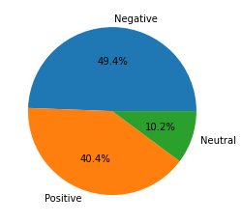
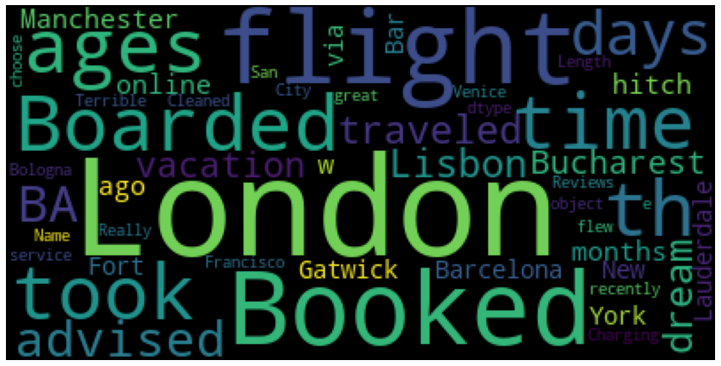
Sentiment Analysis and Wordcloud
After performing web scraping and loading, and cleaning the data, I first used vaderSentiment to give each review a positive/negative/neutral rating based on its content. After counting all of the results, I plotted this on a pie chart to show the proportion of reviewers who felt they had a good or bad time flying with us. From this pie chart it appears that the overall sentiment is slightly positive. Furthermore, it should be noted that people will typically be more likely to leave a review if they had a bad experience as opposed to a good one, so this is a strong indication that we are succeeding in our reputation with our customers. I also used a wordcloud program to plot the most frequent words in reviews, although the results of this are fairly neutral and mostly focus on different airport/destination related key-words

